Slide 1
Module 3
Process Scheduling
Slides are taken from Abraham Silberschatz, Peter B. Galvin, Greg Gagne, "Operating System Concepts", Wiley, 10th Edition, 2018

Slide 2
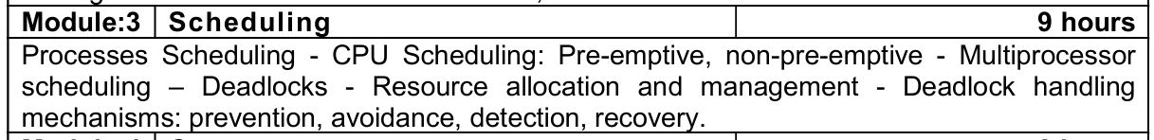

Slide 3
CPU Scheduling

Slide 4
CPU Scheduler
The CPU scheduler selects from among the processes in ready queue, and allocates a CPU core to one of them
  Queue may be ordered in various ways
CPU scheduling decisions may take place when a process:
  1. Switches from running to waiting state
  2. Switches from running to ready state
  3. Switches from waiting to ready
  Terminates
For situations 1 and 4, there is no choice in terms of scheduling. A new process (if one exists in the ready queue) must be selected for execution.
For situations 2 and 3, however, there is a choice.

Slide 5
Preemptive and Nonpreemptive Scheduling
When scheduling takes place only under circumstances 1 and 4, the scheduling scheme is nonpreemptive.
Otherwise, it is preemptive.
Under Nonpreemptive scheduling, once the CPU has been allocated to a process, the process keeps the CPU until it releases it either by terminating or by switching to the waiting state.
Virtually all modern operating systems including Windows, MacOS, Linux, and UNIX use preemptive scheduling algorithms.

Slide 6
Preemptive Scheduling and Race Conditions
Preemptive scheduling can result in race conditions when data are shared among several processes.
Consider the case of two processes that share data. While one process is updating the data, it is preempted so that the second process can run. The second process then tries to read the data, which are in an inconsistent state.

Slide 7
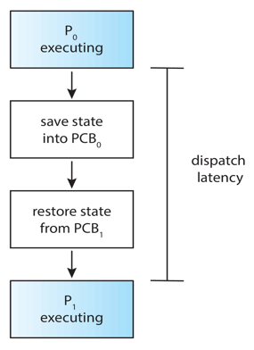
Dispatcher
Dispatcher module gives control of the CPU to the process selected by the CPU scheduler; this involves:
  Switching context
  Switching to user mode
  Jumping to the proper location in the user program to restart that program
Dispatch latency – time it takes for the dispatcher to stop one process and start another running

Slide 8
Scheduling Criteria
CPU utilization – keep the CPU as busy as possible
Throughput – # of processes that complete their execution per time unit
Turnaround time – amount of time to execute a particular process
Waiting time – amount of time a process has been waiting in the ready queue
Response time – amount of time it takes from when a request was submitted until the first response is produced.
The number of processes currently in memory is known as the degree of multiprogramming.

Slide 9
Scheduling Algorithm Optimization Criteria
Max CPU utilization
Max throughput
Min turnaround time
Min waiting time
Min response time

Slide 10
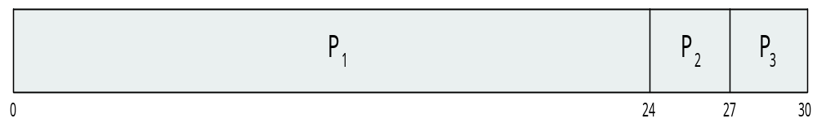
First- Come, First-Served (FCFS) Scheduling
Process Burst Time
P₁ 24
P₂ 3
P₃ 3
Suppose that the processes arrive in the order: P₁ , P₂ , P₃
The Gantt Chart for the schedule is:
Waiting time for P₁ = 0; P₂ = 24; P₃ = 27
Average waiting time: (0 + 24 + 27)/3 = 17

Slide 11
First- Come, First-Served (FCFS) Scheduling
CT – Completion Time
TAT – Turn Around Time = WT + BT
WT – Waiting Time
RT – Response Time (First Submission Time – Arrival Time)
1)Arrival Order
Arrival Time
Process | Burst Time(BT) | CT | TAT = CT-AT | WT = TAT-BT | RT | Context Switch (1ms)
P1 | 2
P2 | 1
P3 | 3
P4 | 5
P5 | 4
2) Gantt Chart:
Average Waiting Time, Average Turnaround Time

Slide 12
First- Come, First-Served (FCFS) Scheduling
CT – Completion Time
TAT – Turn Around Time = WT + BT
WT – Waiting Time
RT – Response Time (First Submission Time – Arrival Time)
Arrival Order
Arrival Time
Process | Arrival Time(AT) | Burst Time(BT) | CT | TAT = CT-AT | WT = TAT-BT | RT | Context Switch (1ms)
P1 | 2 | 2 | 4 | 2 | 0 | 0
P2 | 0 | 1 | 1 | 1 | 0 | 0
P3 | 2 | 3 | 7 | 5 | 2 | 2
P4 | 3 | 5 | 12 | 9 | 4 | 4
P5 | 4 | 4 | 16 | 12 | 8 | 8
Gantt Chart:
Average Waiting Time, Average Turnaround Time

Slide 13
First- Come, First-Served (FCFS) Scheduling
With CPU Burst time and IO Time
Three processes P1, P2 and P3 with process time 20, 30, 10 respectively. Each process uses the first 30% of its process time in CPU, then 50% in IO and the last 20% in CPU. Draw Gantt Chart and find average TAT and AWT.

Slide 14
Three processes P1, P2 and P3 with process time 20, 30, 10 respectively. Each process uses the first 30% of its process time in CPU, then 50% in IO and the last 20% in CPU. Draw Gantt Chart and find average TAT and AWT.
Process | Arrival Time | Process Time | CPU BT (30%) | IO (50%) | CPU BT (20%) | CT | TAT | WT | RT
P1 | 0 | 20 | 6 | 10 | 4 | 22 | 22 | 12 | 0
P2 | 0 | 30 | 9 | 15 | 6 | 36 | 36 | 21 | 6
P3 | 0 | 10 | 3 | 5 | 2 | 25 | 25 | 20 | 15
P1 will come back at
P2 will come back at
P3 will come back at
Gantt Chart:
P1 | P2 | P3 | P1 | Idle | P3 | Idle | P2
0
6
15
18
22
23
25
30
36

Slide 15

FCFS Scheduling (Cont.)
Suppose that the processes arrive in the order:
P₂ , P₃ , P₁
The Gantt chart for the schedule is:
Waiting time for P₁ = 6; P₂ = 0; P₃ = 3
Average waiting time: (6 + 0 + 3)/3 = 3
Much better than previous case
Convoy effect - short process behind long process
  Consider one CPU-bound and many I/O-bound processes

Slide 16
Shortest-Job-First (SJF) Scheduling
Associate with each process the length of its next CPU burst
  Use these lengths to schedule the process with the shortest time
SJF is optimal – gives minimum average waiting time for a given set of processes
Preemptive version called shortest-remaining-time-first
How do we determine the length of the next CPU burst?
  Could ask the user
  Estimate

Slide 17
Shortest-Job-First (SJF) Scheduling – Non Preemptive
1)Arrival Order
Arrival Time
CT – Completion Time
TAT – Turn Around Time = WT + BT
WT – Waiting Time
RT – Response Time (First Submission Time – Arrival Time)
Process | Burst Time(BT) | CT | TAT = CT-AT | WT = TAT-BT | RT | Context Switch (1ms)
P1 | 6
P2 | 8
P3 | 7
P4 | 3
2) Gantt Chart:
Average Waiting Time, Average Turnaround Time

Slide 18
Shortest-Job-First (SJF) Scheduling – Non Preemptive
1)Arrival Order
Arrival Time
CT – Completion Time
TAT – Turn Around Time = WT + BT
WT – Waiting Time
RT – Response Time (First Submission Time – Arrival Time)
Process | Arrival Time(AT) | Burst Time(BT) | CT | TAT = CT-AT | WT = TAT-BT | RT | Context Switch (1ms)
P1 | 0 | 6
P2 | 2 | 8
P3 | 3 | 7
P4 | 4 | 3
2) Gantt Chart:
Average Waiting Time, Average Turnaround Time

Slide 19
Shortest Remaining Time First (SRTF)
SJF - Preemptive Scheduling
Process | Arrival Time(AT) | Burst Time(BT) | CT | TAT = CT-AT | WT | RT | Context Switch (1ms)
P1 | 0 | 8
P2 | 1 | 4
P3 | 2 | 9
P4 | 3 | 5
Gantt Chart:
Average Waiting Time, Average Turnaround Time

Slide 20
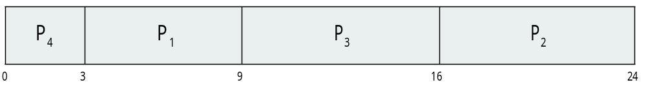
Example of SJF
Process Burst Time
P₁ 6
P₂ 8
P₃ 7
P₄ 3
SJF scheduling chart
Average waiting time = (3 + 16 + 9 + 0) / 4 = 7

Slide 21

SJF – Preemptive Scheduling
Example of Shortest-remaining-time-first
Now we add the concepts of varying arrival times and preemption to the analysis
Process i Arrival TimeT Burst Time
P₁ 0 8
P₂ 1 4
P₃ 2 9
P₄ 3 5
Preemptive SJF Gantt Chart
Average waiting time = [(10-1)+(1-1)+(17-2)+(5-3)]/4 = 26/4 = 6.5

Slide 22
Round Robin (RR)
Each process gets a small unit of CPU time (time quantum q), usually 10-100 milliseconds. After this time has elapsed, the process is preempted and added to the end of the ready queue.
If there are n processes in the ready queue and the time quantum is q, then each process gets 1/n of the CPU time in chunks of at most q time units at once. No process waits more than (n-1)q time units.
Timer interrupts every quantum to schedule next process
Performance
  q large ⇒ FIFO (FCFS)
  q small ⇒ RR
Note that q must be large with respect to context switch, otherwise overhead is too high

Slide 23

Example of RR with Time Quantum = 4
Process Burst Time
P₁ 24
P₂ 3
P₃ 3
The Gantt chart is:
Typically, higher average turnaround than SJF, but better response
q should be large compared to context switch time
  q usually 10 milliseconds to 100 milliseconds,
  Context switch < 10 microseconds

Slide 24
Round Robin (RR) Scheduling
Process | Burst Time(BT) | CT | TAT = CT-AT | WT | RT | Context Switch (1ms)
P1 | 24
P2 | 3
P3 | 3
Convoy effect occurs in First-Come-First-Serve (FCFS) scheduling when one long process delays all shorter ones, while starvation happens in priority-based scheduling when low-priority processes wait indefinitely because higher-priority tasks keep getting CPU time. Both degrade system performance but in different ways.
Gantt Chart:
Average Waiting Time, Average Turnaround Time

Slide 25
Round Robin (RR) Scheduling
Time Quantum = 3
Process | Arrival Time(AT) | Burst Time(BT) | CT | TAT = CT-AT | WT | RT | Context Switch (1ms)
P1 | 0 | 8
P2 | 5 | 2
P3 | 1 | 7
P4 | 6 | 3
P5 | 8 | 5

Slide 26
Priority Scheduling
A priority number (integer) is associated with each process
The CPU is allocated to the process with the highest priority (smallest integer ≡ highest priority)
  Preemptive
  Nonpreemptive
SJF is priority scheduling where priority is the inverse of predicted next CPU burst time
Problem ≡ Starvation – low priority processes may never execute
Solution ≡ Aging – as time progresses increase the priority of the process

Slide 27
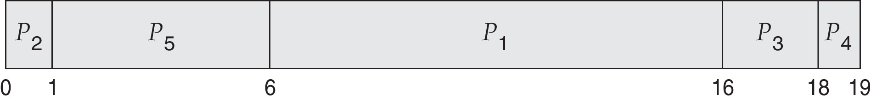
Example of Priority Scheduling
Process Burst Time Priority
P₁ 10 3
P₂ 1 1
P₃ 2 4
P₄ 1 5
P₅ 5 2
Priority scheduling Gantt Chart
Average waiting time = 8.2

Slide 28
Priority Scheduling – Non Preemptive
If same priority for more processes, use FCFS or Round Robin Scheduling
1. With FCFS
Process | Burst Time(BT) | Priority | CT | TAT = CT-AT | WT | RT | Context Switch (1ms)
P1 | 4 | 3
P2 | 5 | 2
P3 | 8 | 2
P4 | 7 | 1
P5 | 3 | 3

Slide 29
Priority Scheduling –Preemptive
If same priority for more processes, use FCFS or Round Robin Scheduling
1. With FCFS
Process | Burst Time(BT) | Priority | AT | CT | TAT = CT-AT | WT | RT | Context Switch (1ms)
P1 | 4 | 3 | 1
P2 | 5 | 2 | 2
P3 | 8 | 2 | 3
P4 | 7 | 1 | 4
P5 | 3 | 3 | 5

Slide 30
Priority Scheduling – Non Preemptive
If same priority for more processes, use FCFS or Round Robin Scheduling
2. With Round Robin
Process | Burst Time(BT) | Priority | CT | TAT = CT-AT | WT | RT | Context Switch (1ms)
P1 | 4 | 3
P2 | 5 | 2
P3 | 8 | 2
P4 | 7 | 1
P5 | 3 | 3
Time Quantum = 2ms
Gantt Chart:
Average Waiting Time, Average Turnaround Time

Slide 31
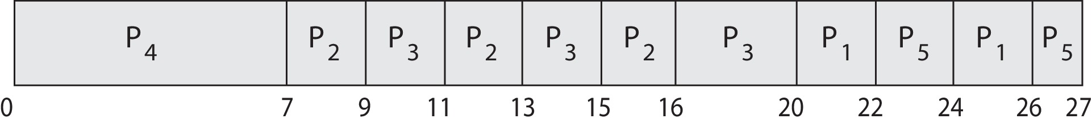
Priority Scheduling w/ Round-Robin
Run the process with the highest priority. Processes with the same priority run round-robin
Example:
Process a Burst Time Priority
P₁ 4 3
P₂ 5 2
P₃ 8 2
P₄ 7 1
P₅ 3 3
Gantt Chart with time quantum = 2

Slide 32
Multilevel Queue
The ready queue consists of multiple queues
Multilevel queue scheduler defined by the following parameters:
  Number of queues
  Scheduling algorithms for each queue
  Method used to determine which queue a process will enter when that process needs service
  Scheduling among the queues

Slide 33
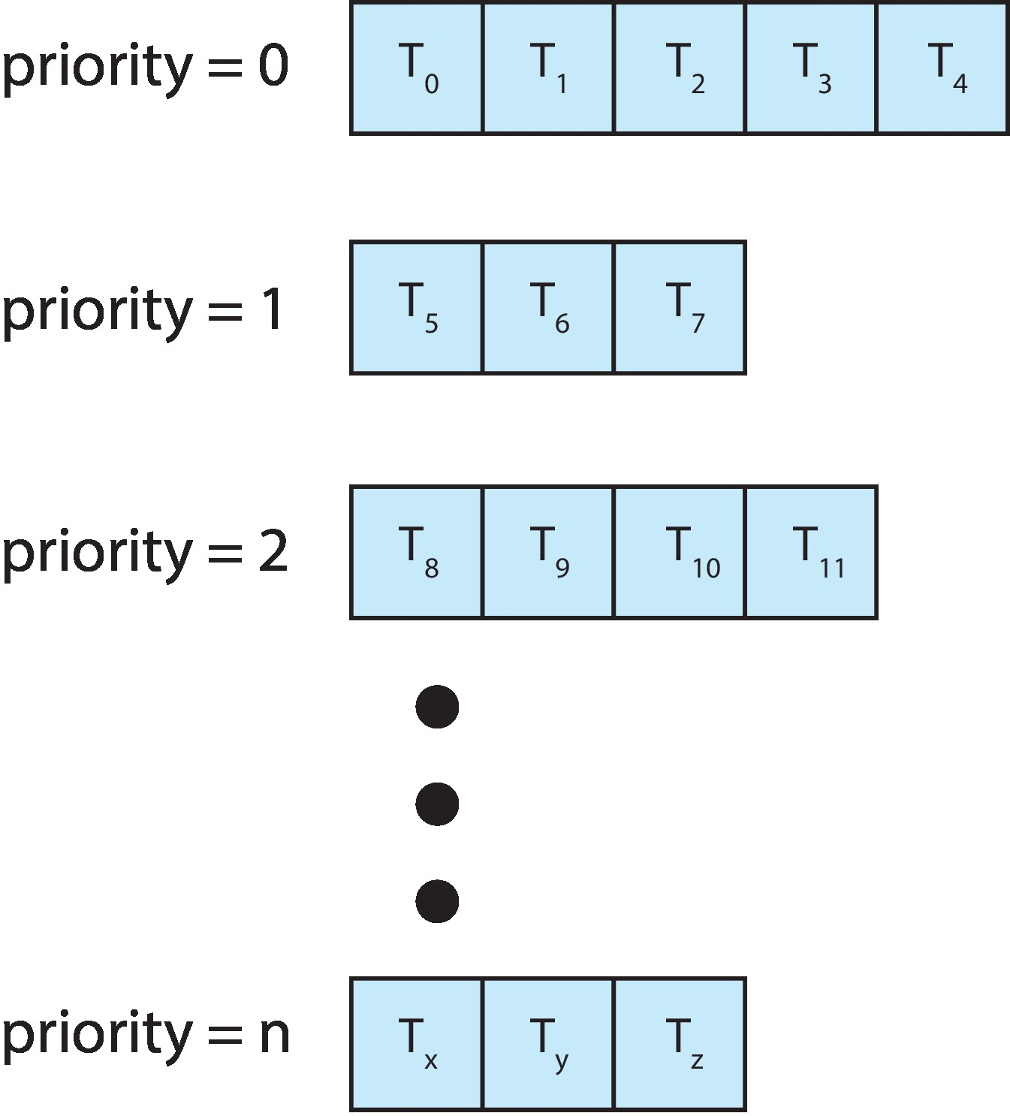
Multilevel Queue
With priority scheduling, have separate queues for each priority.
Schedule the process in the highest-priority queue!

Slide 34
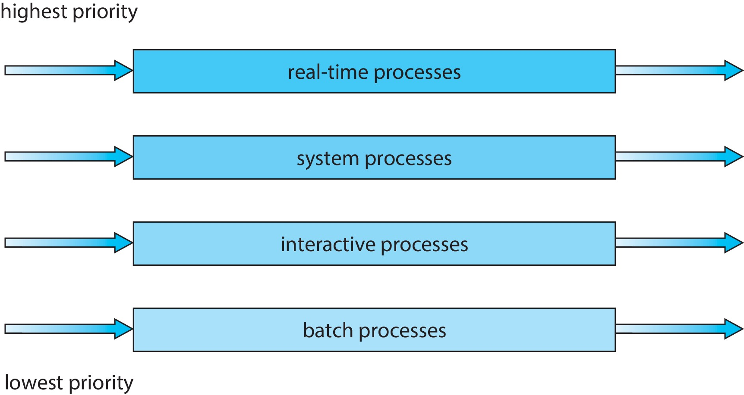
Multilevel Queue
Prioritization based upon process type

Slide 35
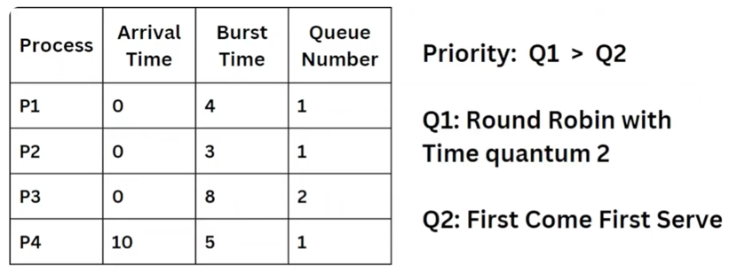
Example
Using Multilevel queuing, calculate ATAT and AWT and Draw Gantt chart

Slide 36
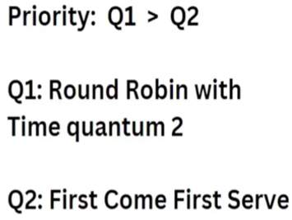
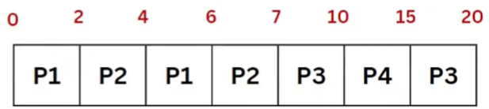
Multilevel Queue Scheduling
Process | Arrival Time | Burst Time | Queue Number | CT | TAT = CT-AT | WT | RT | Context Switch
P1 | 0 | 4 | 1
P2 | 0 | 3 | 1
P3 | 0 | 8 | 2
P4 | 10 | 5 | 1

Slide 37
Multilevel Feedback Queue
A process can move between the various queues.
Multilevel-feedback-queue scheduler defined by the following parameters:
  Number of queues
  Scheduling algorithms for each queue
  Method used to determine when to upgrade a process
  Method used to determine when to demote a process
  Method used to determine which queue a process will enter when that process needs service
Aging can be implemented using multilevel feedback queue

Slide 38

Example of Multilevel Feedback Queue
Three queues:
  Q₀ – RR with time quantum 8 milliseconds
  Q₁ – RR time quantum 16 milliseconds
  Q₂ – FCFS
Scheduling
  A new process enters queue Q₀ which is served in RR
    When it gains CPU, the process receives 8 milliseconds
    If it does not finish in 8 milliseconds, the process is moved to queue Q₁
  At Q₁ job is again served in RR and receives 16 additional milliseconds
    If it still does not complete, it is preempted and moved to queue Q₂

Slide 39
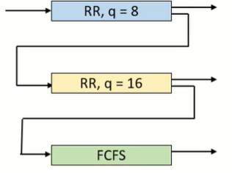
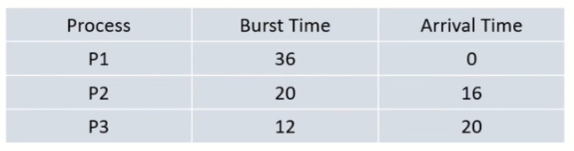
Multilevel Feedback Queue
Using Multilevel feedback queuing, calculate ATAT and AWT and Draw Gantt chart.

Slide 40
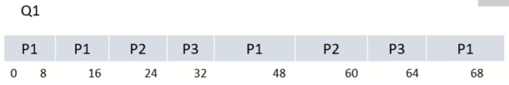
Multilevel feedback Queue Scheduling
Process | Arrival Time | Burst Time | CT | TAT = CT-AT | WT | RT | Context Switch
P1 | 0 | 36
P2 | 16 | 20
P3 | 20 | 12

Slide 41
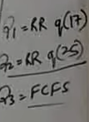
Multilevel feedback Queue Scheduling – Ex. 2
Process | Arrival Time | Burst Time | CT | TAT = CT-AT | WT | RT | Context Switch
P1 | 0 | 53
P2 | 0 | 17
P3 | 0 | 68
P4 | 0 | 24

Slide 42
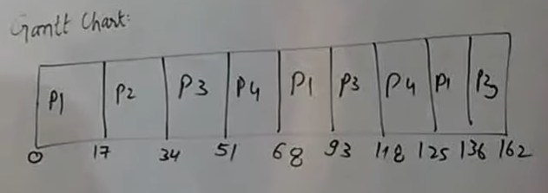
Gantt Chart

Slide 43
Deadlocks

Slide 44
Outline
System Model
Deadlock Characterization
Methods for Handling Deadlocks
Deadlock Prevention
Deadlock Avoidance
Deadlock Detection
Recovery from Deadlock

Slide 45
Objectives
Illustrate how deadlock can occur when mutex locks are used
Define the four necessary conditions that characterize deadlock
Identify a deadlock situation in a resource allocation graph
Evaluate the four different approaches for preventing deadlocks
Apply the banker’s algorithm for deadlock avoidance
Apply the deadlock detection algorithm
Evaluate approaches for recovering from deadlock

Slide 46
System Model
System consists of resources
Resource types R₁, R₂, . . ., R_{m}
  CPU cycles, memory space, I/O devices
Each resource type R_{i} has W_{i} instances.
Each process utilizes a resource as follows:
  request
  use
  release

Slide 47
Deadlock with Semaphores
Data:
  A semaphore S₁ initialized to 1
  A semaphore S₂ initialized to 1
Two threads T₁ and T₂
T₁:
wait(s₁)
wait(s₂)
T₂:
wait(s₂)
wait(s₁)

Slide 48
Deadlock Characterization
Deadlock can arise if four conditions hold simultaneously.
Mutual exclusion: only one thread at a time can use a resource
Hold and wait: a thread holding at least one resource is waiting to acquire additional resources held by other threads
No preemption: a resource can be released only voluntarily by the thread holding it, after that thread has completed its task
Circular wait: there exists a set {T₀, T₁, …, T_{n}} of waiting threads such that T₀ is waiting for a resource that is held by T₁, T₁ is waiting for a resource that is held by T₂, …, T_{n–1} is waiting for a resource that is held by T_{n}, and T_{n} is waiting for a resource that is held by T₀.

Slide 49
Resource-Allocation Graph
Deadlocks can be described more precisely in terms of a directed graph called a system resource-allocation graph.
A set of vertices V and a set of edges E.
V is partitioned into two types:
  T = {T₁, T₂, …, T_{n}}, the set consisting of all the threads in the system.
  R = {R₁, R₂, …, R_{m}}, the set consisting of all resource types in the system
request edge – directed edge T_{i} → R_{j}
assignment edge – directed edge R_{j} → T_{i}

Slide 50
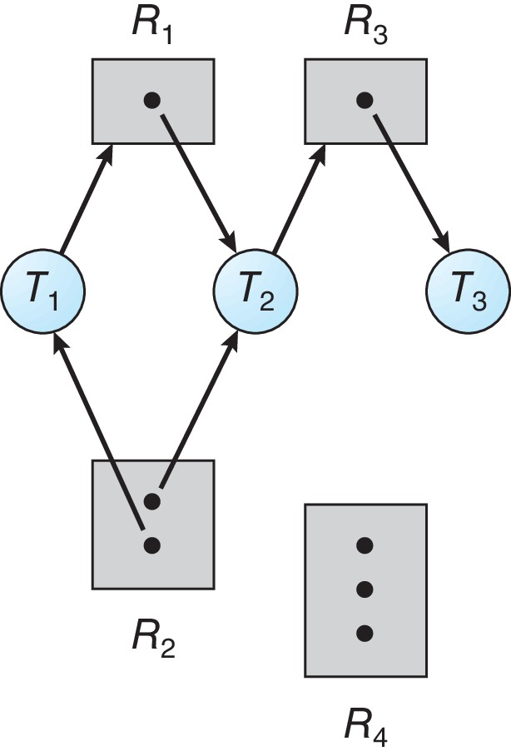
Resource Allocation Graph Example
One instance of R₁
Two instances of R₂
One instance of R₃
Three instance of R₄
T₁ holds one instance of R₂ and is waiting for an instance of R₁
T₂ holds one instance of R₁, one instance of R₂, and is waiting for an instance of R₃
T₃ is holds one instance of R₃

Slide 51
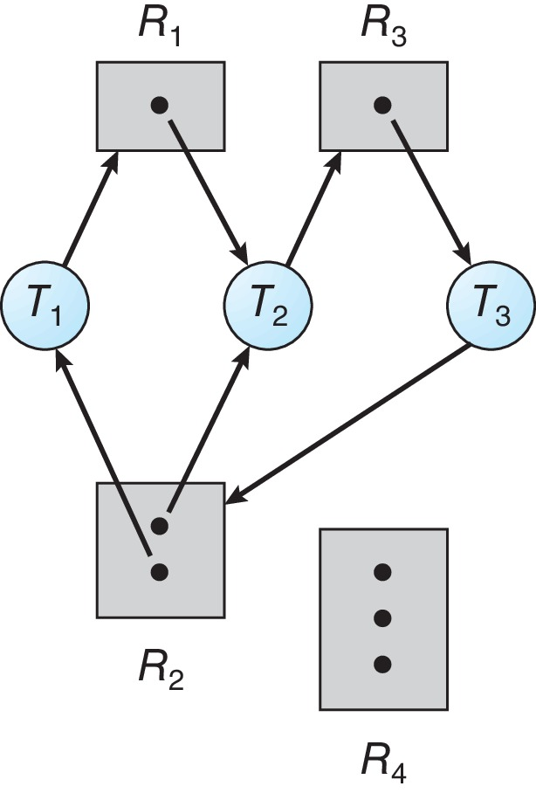
Resource Allocation Graph with a Deadlock
If the graph does contain a cycle, then a deadlock may exist.

Slide 52
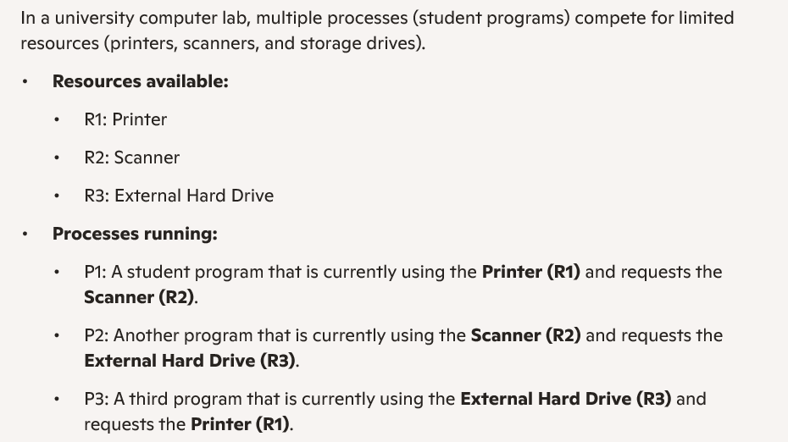
Draw RAG and check for deadlock

Slide 53
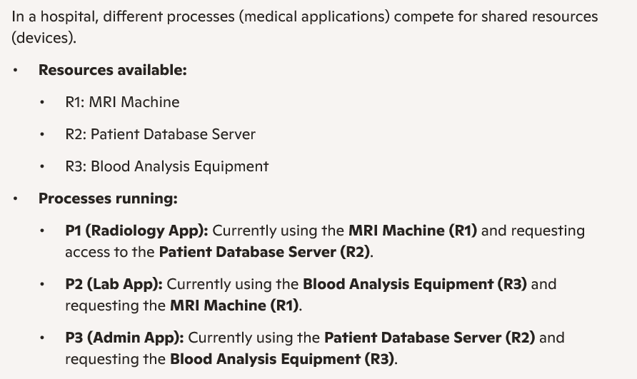
Draw RAG and check for deadlock

Slide 54

Graph with a Cycle But no Deadlock

Slide 55
Basic Facts
If graph contains no cycles ⇒ no deadlock
If graph contains a cycle ⇒
  if only one instance per resource type, then deadlock
  if several instances per resource type, possibility of deadlock

Slide 56
Methods for Handling Deadlocks
Ensure that the system will never enter a deadlock state:
  Deadlock prevention
  Deadlock avoidance
Allow the system to enter a deadlock state and then recover
Ignore the problem and pretend that deadlocks never occur in the system.

Slide 57
Deadlock Prevention
Invalidate one of the four necessary conditions for deadlock:
Mutual Exclusion – not required for sharable resources (e.g., read-only files); must hold for non-sharable resources
Hold and Wait – must guarantee that whenever a thread requests a resource, it does not hold any other resources
  Require threads to request and be allocated all its resources before it begins execution or allow thread to request resources only when the thread has none allocated to it.
  Low resource utilization; starvation possible

Slide 58
Deadlock Prevention (Cont.)
No Preemption:
  If a process that is holding some resources requests another resource that cannot be immediately allocated to it, then all resources currently being held are released
  Preempted resources are added to the list of resources for which the thread is waiting
  Thread will be restarted only when it can regain its old resources, as well as the new ones that it is requesting
  If a process is requesting a resource but it is held up with other waiting process, then the resource will be preempted from the waiting process and will be allocated to the requested process.
Circular Wait:
  Impose a total ordering of all resource types, and require that each thread requests resources in an increasing order of enumeration

Slide 59
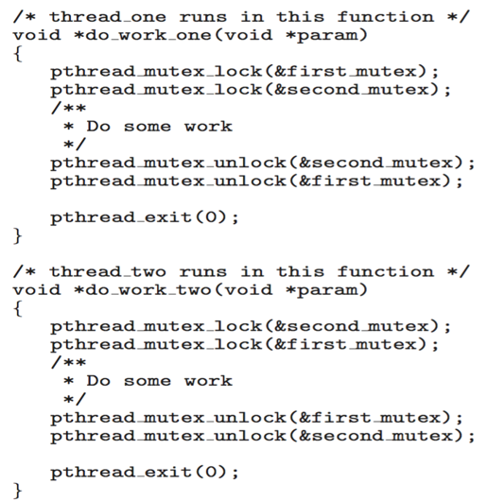
Circular Wait
Invalidating the circular wait condition is most common.
Simply assign each resource (i.e., mutex locks) a unique number.
Resources must be acquired in order.
If:
first_mutex = 1
second_mutex = 5
code for thread_two could
not be written as follows:

Slide 60
Deadlock Avoidance
Requires that the system has some additional a priori information
available
Simplest and most useful model requires that each thread declare the maximum number of resources of each type that it may need
The deadlock-avoidance algorithm dynamically examines the resource-allocation state to ensure that there can never be a circular-wait condition
Resource-allocation state is defined by the number of available and allocated resources, and the maximum demands of the processes

Slide 61
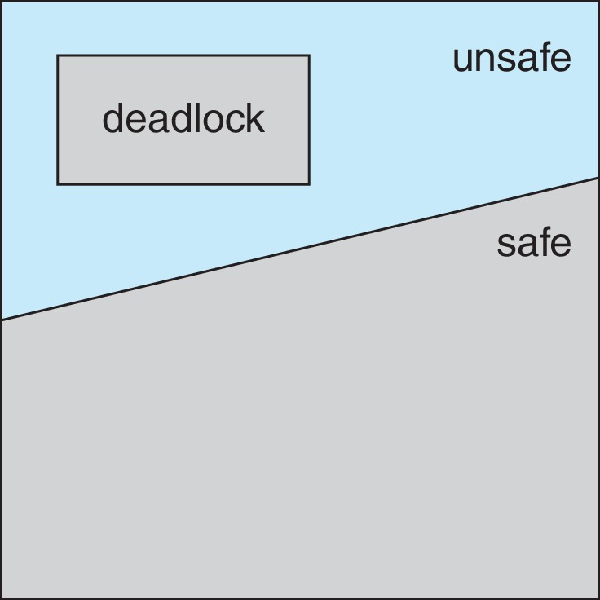
Safe, Unsafe, Deadlock State

Slide 62
Safe State
When a thread requests an available resource, system must decide if immediate allocation leaves the system in a safe state
System is in safe state if there exists a sequence <T₁, T₂, …, T_{n}> of ALL the threads in the systems such that for each T_{i}, the resources that T_{i} can still request can be satisfied by currently available resources + resources held by all the T_{j}, with j < I
That is:
  If T_{i} resource needs are not immediately available, then T_{i} can wait until all T_{j} have finished
  When T_{j} is finished, T_{i} can obtain needed resources, execute, return allocated resources, and terminate
  When T_{i} terminates, T_{i +1} can obtain its needed resources, and so on

Slide 63
Basic Facts
If a system is in safe state ⇒ no deadlocks
If a system is in unsafe state ⇒ possibility of deadlock
Avoidance ⇒ ensure that a system will never enter an unsafe state.

Slide 64
Avoidance Algorithms
Single instance of a resource type
  Use a resource-allocation graph
Multiple instances of a resource type
  Use the Banker’s Algorithm

Slide 65
Resource-Allocation Graph Scheme
Claim edge T_{i} → R_{j} indicated that process T_{j} may request resource R_{j}; represented by a dashed line
Claim edge converts to request edge when a thread requests a resource
Request edge converted to an assignment edge when the resource is allocated to the thread
When a resource is released by a thread, assignment edge reconverts to a claim edge
Resources must be claimed a priori in the system

Slide 66
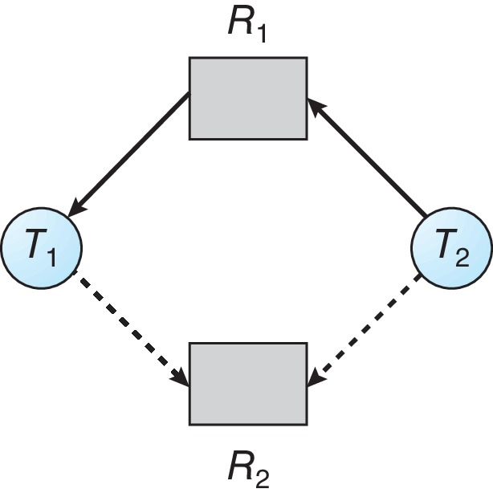
Resource-Allocation Graph

Slide 67
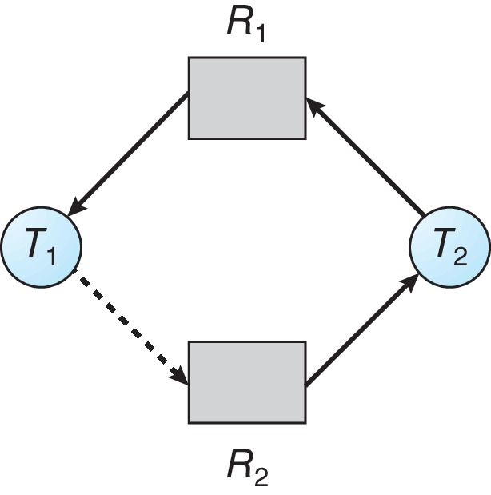
Unsafe State In Resource-Allocation Graph

Slide 68
Resource-Allocation Graph Algorithm
Suppose that thread T_{i} requests a resource R_{j}
The request can be granted only if converting the request edge to an assignment edge does not result in the formation of a cycle in the resource allocation graph

Slide 69
Banker’s Algorithm
Multiple instances of resources
Each thread must a priori claim maximum use
When a thread requests a resource, it may have to wait
When a thread gets all its resources it must return them in a finite amount of time

Slide 70
Data Structures for the Banker’s Algorithm
Let n = number of processes, and m = number of resources types.
Available: Vector of length m. If available [j] = k, there are k instances of resource type R_{j} available
Max: n x m matrix. If Max [i,j] = k, then process T_{i} may request at most k instances of resource type R_{j}
Allocation: n x m matrix. If Allocation[i,j] = k then T_{i} is currently allocated k instances of R_{j}
Need: n x m matrix. If Need[i,j] = k, then T_{i} may need k more instances of R_{j} to complete its task
    Need [i,j] = Max[i,j] – Allocation [i,j]

Slide 71
Safety Algorithm
Let Work and Finish be vectors of length m and n, respectively. Initialize:
      Work = Available
      Finish [i] = false for i = 0, 1, …, n- 1
Find an i such that both:
  (a) Finish [i] = false
  (b) Need_{i} ≤ Work
  If no such i exists, go to step 4
Work = Work + Allocation_{i}
Finish[i] = true
go to step 2
If Finish [i] == true for all i, then the system is in a safe state

Slide 72
Resource-Request Algorithm for Process P_{i}
Request_{i} = request vector for process T_{i}. If Request_{i} [j] = k then process T_{i} wants k instances of resource type R_{j}
  If Request_{i} ≤ Need_{i} go to step 2. Otherwise, raise error condition, since process has exceeded its maximum claim
  If Request_{i} ≤ Available, go to step 3. Otherwise T_{i} must wait, since resources are not available
  Pretend to allocate requested resources to T_{i} by modifying the state as follows:
      Available = Available – Request_{i};
      Allocation_{i} = Allocation_{i} + Request_{i};
      Need_{i} = Need_{i} – Request_{i};
    If safe ⇒ the resources are allocated to T_{i}
    If unsafe ⇒ T_{i} must wait, and the old resource-allocation state is restored

Slide 73
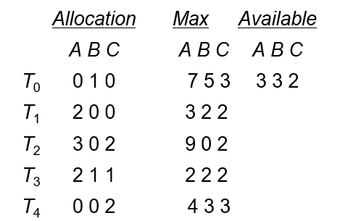
Example of Banker’s Algorithm
5 threads T₀ through T₄;
3 resource types:
A (10 instances), B (5instances), and C (7 instances)
Snapshot at time T₀:
Answer the following questions using the banker’s algorithm:
a. What is the content of the matrix Need?
b. Is the system in a safe state?
c. If a request from thread T1 arrives for (1,0,2), can the request be granted immediately?

Slide 74
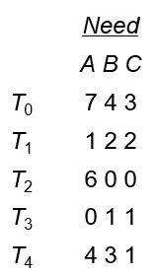
Example (Cont.)
The content of the matrix Need is defined to be Max – Allocation
The system is in a safe state since the sequence < T₁, T₃, T₄, T₂, T₀> satisfies safety criteria

Slide 75
Work = Available Finish [i] = false T0 Finish [i] = false Need_{i} ≤ Work Work = Work + Allocation_{i} Work = Finish[i] = | Work = T1 Finish [i] = false Need_{i} ≤ Work Work = Work + Allocation_{i} Work = Finish[i] = | Work = T2 Finish [i] = false Need_{i} ≤ Work Work = Work + Allocation_{i} Work = Finish[i] =

Slide 76
T1 arrives for (1,0,2), can the request be granted immediately?
Request ≤ Need Request_{i} ≤ Available Available = Available – Requesti; Allocationi = Allocationi + Requesti; Needi = Needi – Requesti; | Work = T Finish [i] = false Need_{i} ≤ Work Work = Work + Allocation_{i} Work = Finish[i] = | Work = T Finish [i] = false Need_{i} ≤ Work Work = Work + Allocation_{i} Work = Finish[i] =

Slide 77
Example: P₁ Request (1,0,2)
Check that Request ≤ Available (that is, (1,0,2) ≤ (3,3,2) ⇒ true
Allocation Need Available
A B C A B C A B C
T₀ 0 1 0 7 4 3 2 3 0
T₁ 3 0 2 0 2 0
T₂ 3 0 2 6 0 0
T₃ 2 1 1 0 1 1
T₄ 0 0 2 4 3 1
Executing safety algorithm shows that sequence < T₁, T₃, T₄, T₀, T₂> satisfies safety requirement
Can request for (3,3,0) by T₄ be granted?
Can request for (0,2,0) by T₀ be granted?

Slide 78
Deadlock Detection
Allow system to enter deadlock state
Detection algorithm
Recovery scheme

Slide 79
Single Instance of Each Resource Type
Maintain wait-for graph
  Nodes are threads
  T_{i} → T_{j} if T_{i} is waiting for T_{j}
Periodically invoke an algorithm that searches for a cycle in the graph. If there is a cycle, there exists a deadlock
An algorithm to detect a cycle in a graph requires an order of n² operations, where n is the number of vertices in the graph

Slide 80
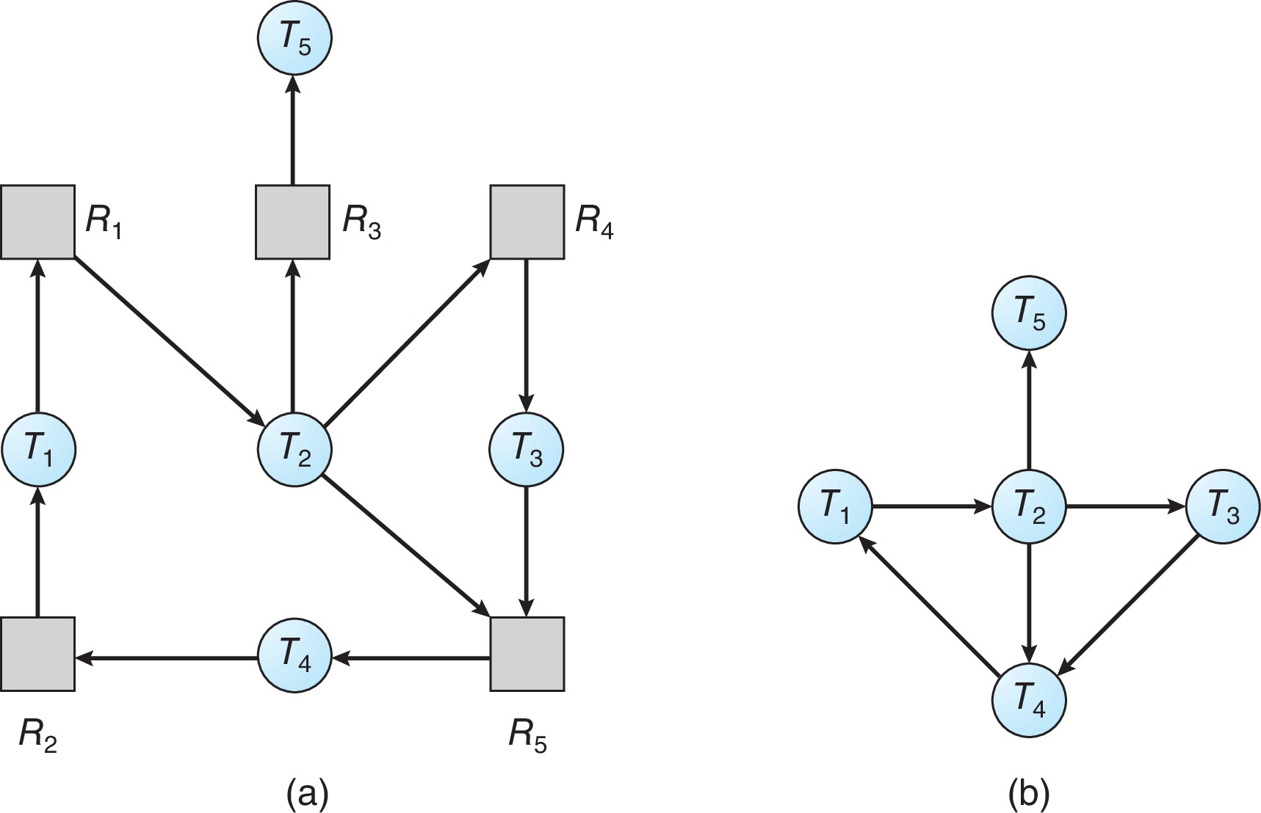
Resource-Allocation Graph and Wait-for Graph
Resource-Allocation Graph
Corresponding wait-for graph

Slide 81
Several Instances of a Resource Type
Available: A vector of length m indicates the number of available resources of each type
Allocation: An n x m matrix defines the number of resources of each type currently allocated to each thread.
Request: An n x m matrix indicates the current request of each thread. If Request [i][j] = k, then thread T_{i} is requesting k more instances of resource type R_{j}.

Slide 82
Detection Algorithm
Let Work and Finish be vectors of length m and n, respectively Initialize:
  Work = Available
  For i = 1,2, …, n, if Allocation_{i} ≠ 0, then
  Finish[i] = false; otherwise, Finish[i] = true
Find an index i such that both:
  Finish[i] == false
  Request_{i} ≤ Work
  If no such i exists, go to step 4

Slide 83
Detection Algorithm (Cont.)
Work = Work + Allocation_{i}
Finish[i] = true
go to step 2
If Finish[i] == false, for some i, 1 ≤ i ≤ n, then the system is in deadlock state. Moreover, if Finish[i] == false, then T_{i} is deadlocked
Algorithm requires an order of O(m x n²) operations to detect whether the system is in deadlocked state

Slide 84
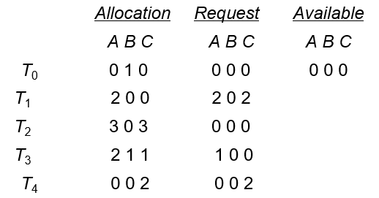
Work = Available Finish [i] = false T0 Finish [i] = false Request_{i} ≤ Work Work = Work + Allocation_{i} Work = Finish[i] = | Work = T1 Finish [i] = false Request_{i} ≤ Work Work = Work + Allocation_{i} Work = Finish[i] = | Work = T2 Finish [i] = false Request_{i} ≤ Work Work = Work + Allocation_{i} Work = Finish[i] =

Slide 85
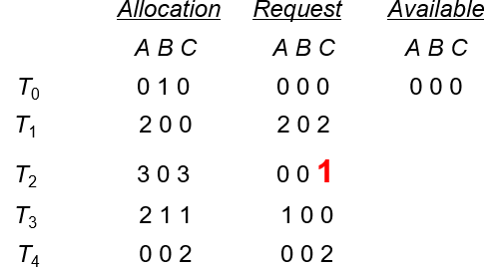
Work = Available Finish [i] = false T0 Finish [i] = false Request_{i} ≤ Work Work = Work + Allocation_{i} Work = Finish[i] = | Work = T1 Finish [i] = false Request_{i} ≤ Work Work = Work + Allocation_{i} Work = Finish[i] = | Work = T2 Finish [i] = false Request_{i} ≤ Work Work = Work + Allocation_{i} Work = Finish[i] =

Slide 86
Example of Detection Algorithm
Five threads T₀ through T₄; three resource types
A (7 instances), B (2 instances), and C (6 instances)
Snapshot at time T₀:
Allocation Request Available
A B C A B C A B C
T₀ 0 1 0 0 0 0 0 0 0
T₁ 2 0 0 2 0 2
T₂ 3 0 3 0 0 1
T₃ 2 1 1 1 0 0
T₄ 0 0 2 0 0 2
Sequence <T₀, T₂, T₃, T₁, T₄> will result in Finish[i] = true for all i

Slide 87
Example (Cont.)
T₂ requests an additional instance of type C
Request
A B C
T₀ 0 0 0
T₁ 2 0 2
T₂ 0 0 1
T₃ 1 0 0
T₄ 0 0 2
State of system?
  Can reclaim resources held by thread T₀, but insufficient resources to fulfill other processes; requests
  Deadlock exists, consisting of processes T₁, T₂, T₃, and T₄

Slide 88
Recovery from Deadlock: Process Termination
Abort all deadlocked threads
Abort one process at a time until the deadlock cycle is eliminated
In which order should we choose to abort?
  Priority of the thread
  How long has the thread computed, and how much longer to completion
  Resources that the thread has used
  Resources that the thread needs to complete
  How many threads will need to be terminated
  Is the thread interactive or batch?

Slide 89
Recovery from Deadlock: Resource Preemption
Selecting a victim – minimize cost
Rollback – return to some safe state, restart the thread for that state
Starvation – same thread may always be picked as victim, include number of rollback in cost factor

